Slide 1


DATA 205 Capstone Project| Professor Lori Perine
ADOLESCENT
Fertility & Out of School
Aashka Navale

Slide 2
Introduction
Project
This projects aims to find the relation between adolescent fertility rates and the percentage of adolescents out of school.
Spreading awareness is the first step to mitigation so if we are able to address these issues in the countries where it is needed most, we could significantly increase their literacy rates and decrease child fertility rates.
1

Slide 3

Introduction
pt. 2
Data
My data consists of 3 total datasets and they all come from the World Bank. Extra information also orginates from the world bank.
female adolescents out of school
male adolescents out of school
adolescent fertility rate
The world by region
World Bank Country and Lending Groups
Tools
RStudio for cleaning, analyses, and graphs
Highcharter for interactive visualizations
Tableau for interactive dashboards
2

Slide 4





Data Cleaning
renamed columns
omitted row
omitted columns (out of school datasets)
mutated to create 2 variables for all datasets
region
income
omitted N/A values from out of school datasets

Slide 5


Descriptive Statistics
Variables
Country
Region
Income
Fertility Rate
years 1960 - 2020
Out of School datasets
years 2000 - 2020
Datasets Overview
Fertility Rate (births per 1000 girls)
217 observations / 8 variables
Female Adolescents Out of School (%)
217 observations / 8 variables
Male Adolescents Out of School (%)
217 observations / 8 variables

Slide 6

Final Data Products

Slide 7
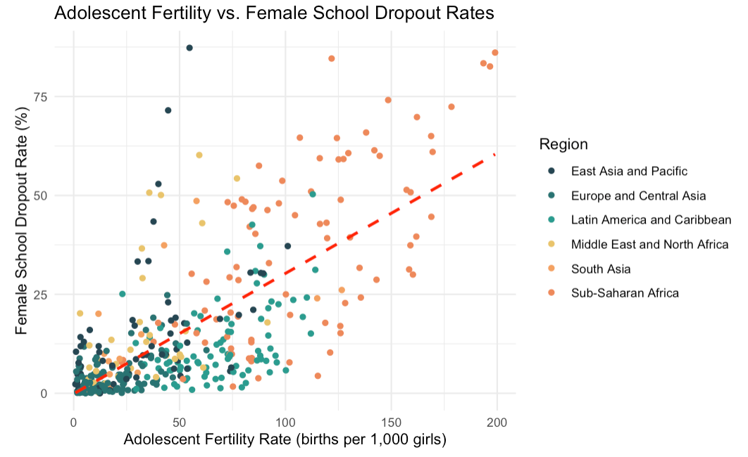
Are changes in adolescent fertility associated with increases or decreases in school dropout rates among adolescent girls?

Slide 8
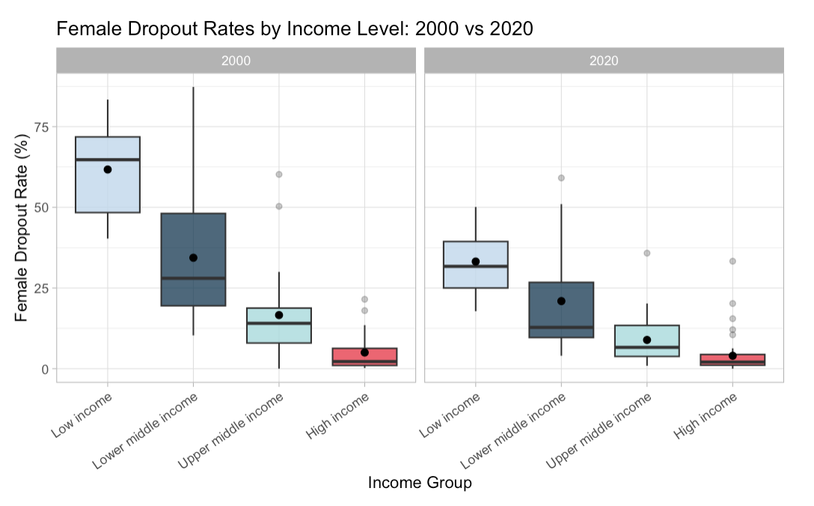
How does national income level affect adolescents’ school attendance rates?

Slide 9
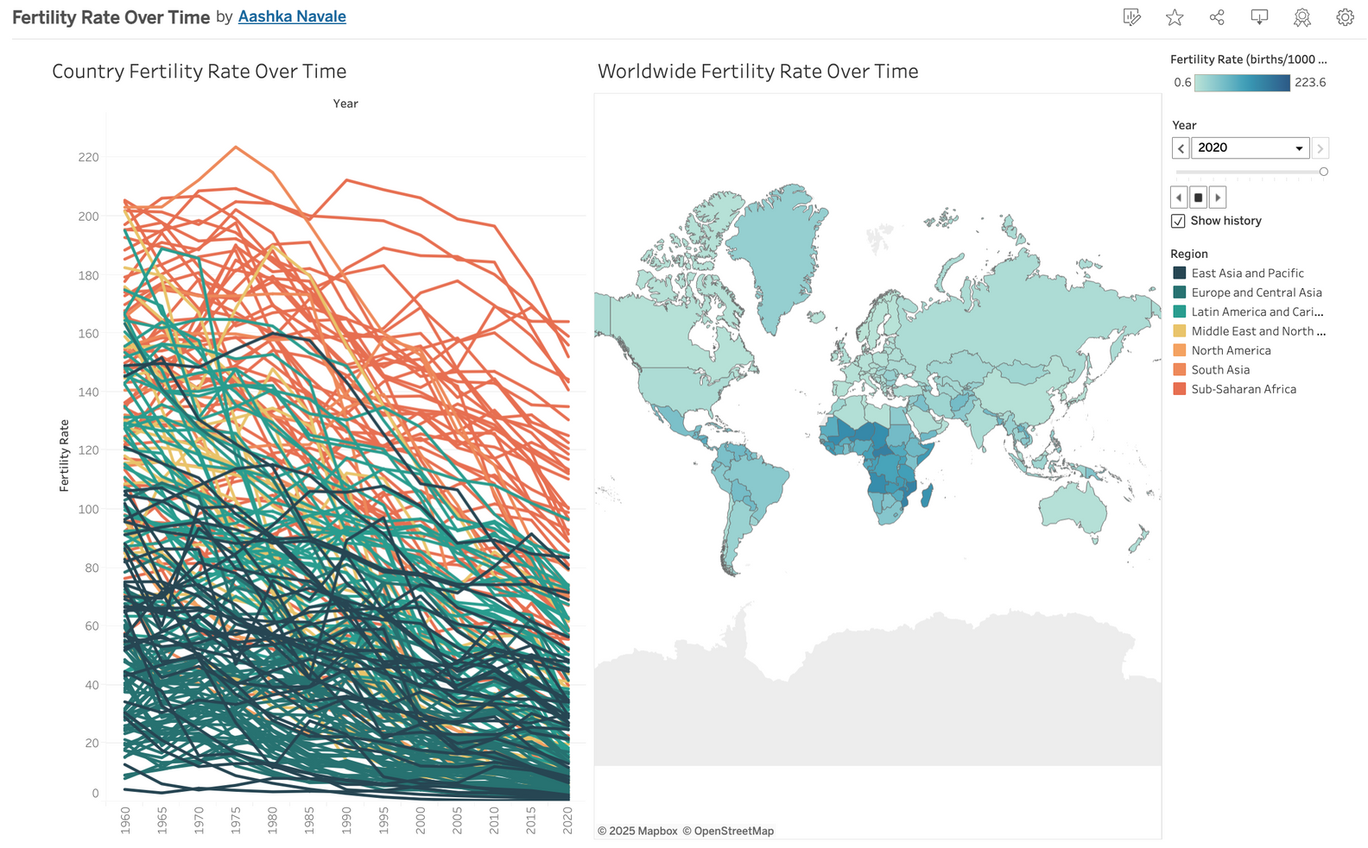

How do adolescent fertility rates vary across world regions, and how have they changed over time?

Slide 10
Conclusion
Sub-Saharan Africa has the most extreme statistics regarding fertility rate and adolescent dropouts
Europe and Central Asia are the highest income region with the lowest fertility rate and adolescent dropouts
Low income groups have higher fertility rates and dropout rates and vice versa for high income
There is a strong correlation between adolescent fertility rate and female dropout rate
Over time, both fertility rates and dropout rates decrease significantly

Slide 11
References & Acknowledgements
Data Sources - World Bank
https://databank.worldbank.org/source/world-development-indicators
https://datatopics.worldbank.org/sdgatlas/archive/2017/the-world-by-region.html
https://datatopics.worldbank.org/world-development-indicators/the-world-by-income-and-region.html
Tools
RStudio
Highcharter
Tableau
Professor Saidi & Professor Alraee
Charlie Roth
Professor Perine

Slide 12


THANK YOU!
Questions?

